Slide 1


SQL Saturday 864
South Florida, United States
June 8, 2019
Hiram Fleitas
Fleitas Arts
github.com/hfleitas/SentimentPrediction
Notes:
Image ref: https://img-prod-cms-rt-microsoft-com.akamaized.net/cms/api/am/imageFileData/RE2ZsFd
https://www.microsoft.com/en-us/ai/business

Slide 2
Sentiment Prediction
Real-time in SQL Server
SQL Server
Machine Learning
Pre-Trained Models
Python
Real-time Scoring
Bonus
Hiram Fleitas
Fleitas Arts
github.com/hfleitas/SentimentPrediction
Notes:
Image ref: https://img-prod-cms-rt-microsoft-com.akamaized.net/cms/api/am/imageFileData/RE2ZsFd
https://www.microsoft.com/en-us/ai/business

Slide 3


Please silence cell phones

Slide 4
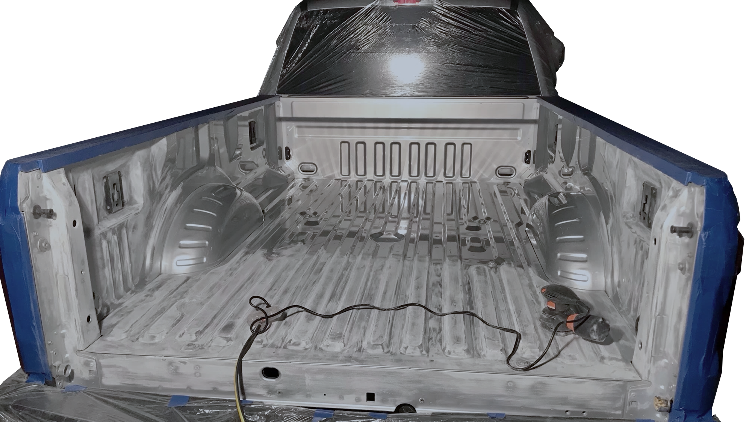

Slide 5
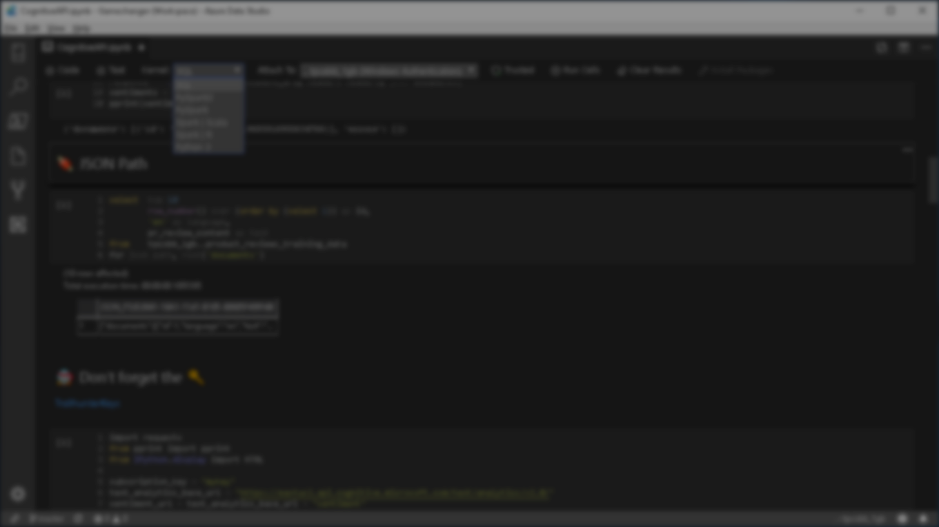







Explore everything PASS has to offer
Free online webinar events
Local user groups around the world
Free 1-day local training events
Free Online Resources
Newsletters
PASS.org
Online special interest user groups
Business analytics training
Get involved

Slide 6
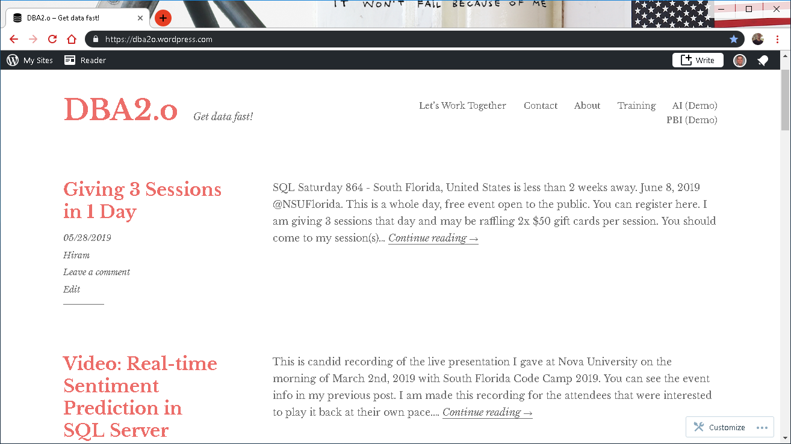

Slide 7

Session evaluations
This is the link:
bit.ly/sqlml19
Your feedback is very important.
Submit your feedback by the end of this presentation.

Slide 8











Hiram Fleitas
Owner Fleitas Arts
Bio
Father
Principal DB Architect
Power BI since 2016
Developer since 1995
SQL Server since 1999
USCG Auxiliary Flotilla Staff Officer
@hiramfleitas
/hfleitas
hiram@fleitasarts.com
hiramfletias
fleitasarts.com

Slide 9
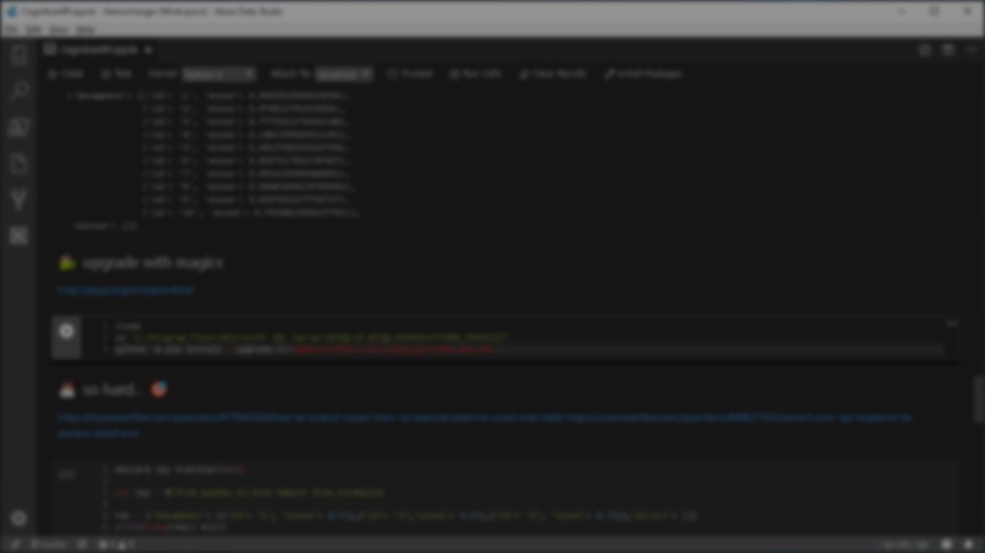

Agenda
Add ML Features
Grant Access
Config
Install Pre-Trained & Open Source ML Models (DNN)
Code in Python and T-SQL
Python Profiling
Real-time scoring
Review Sentiment Results
Bonus
Resources

Slide 10

DEMO
SQL Server ML & AI

Slide 11
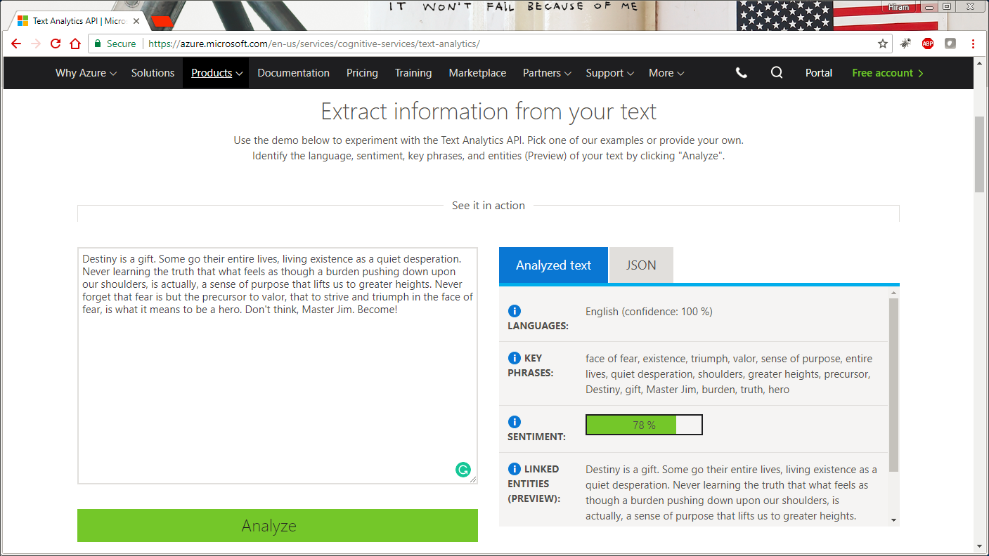

Notes:
https://www.netflix.com/title/80075820

Slide 12
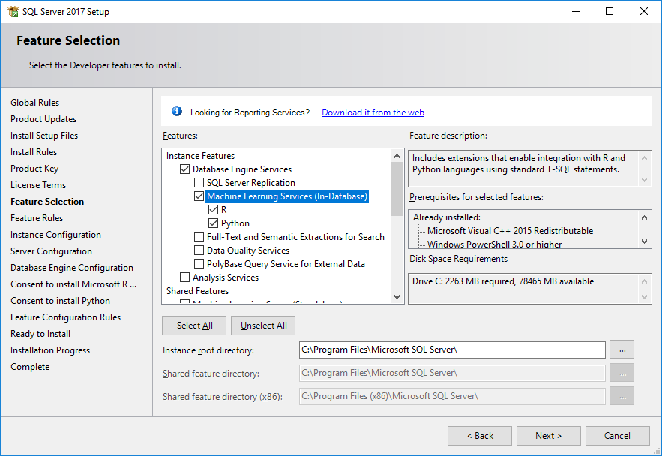

Slide 13
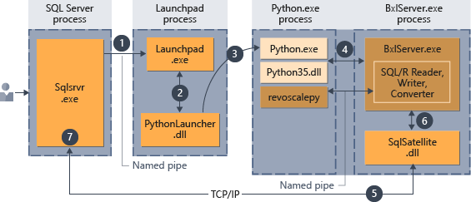
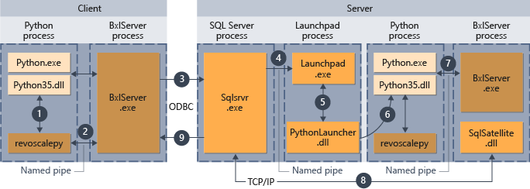

Slide 14
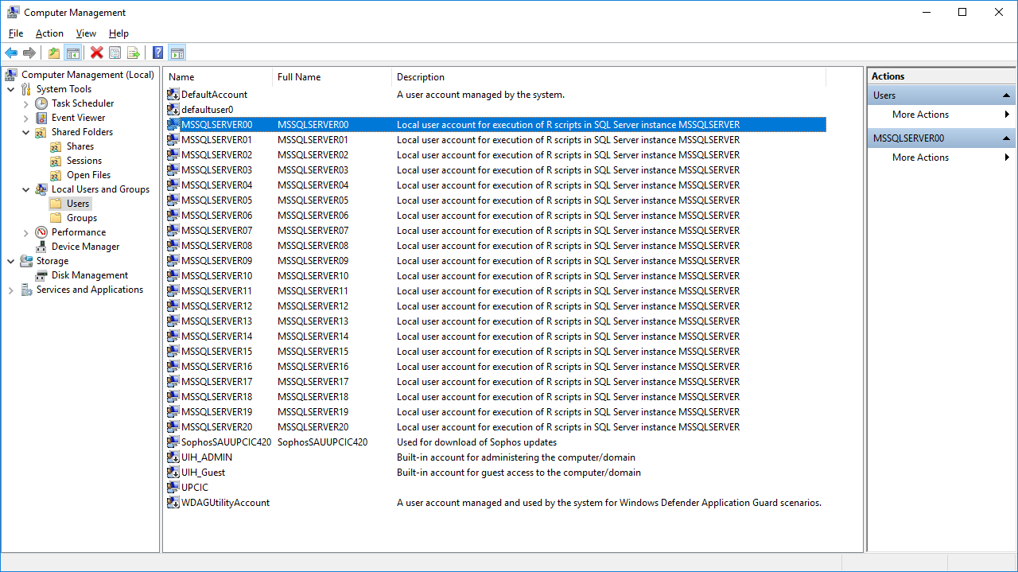

Slide 15
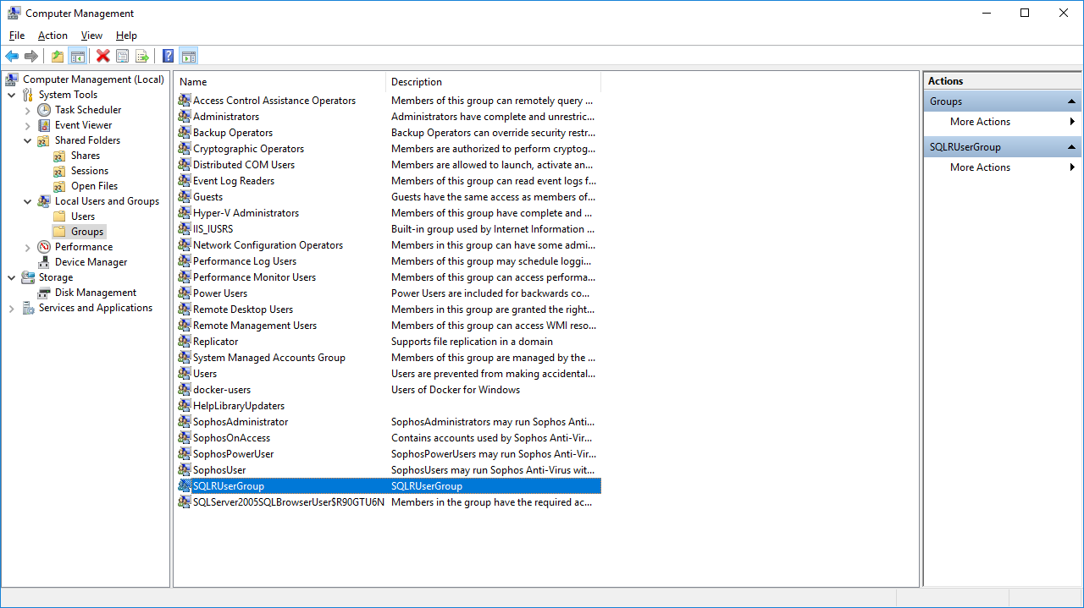
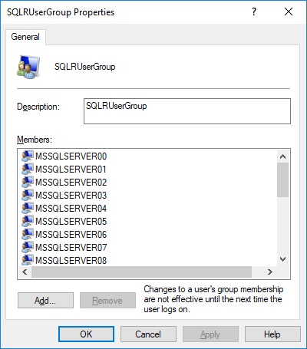

Slide 16
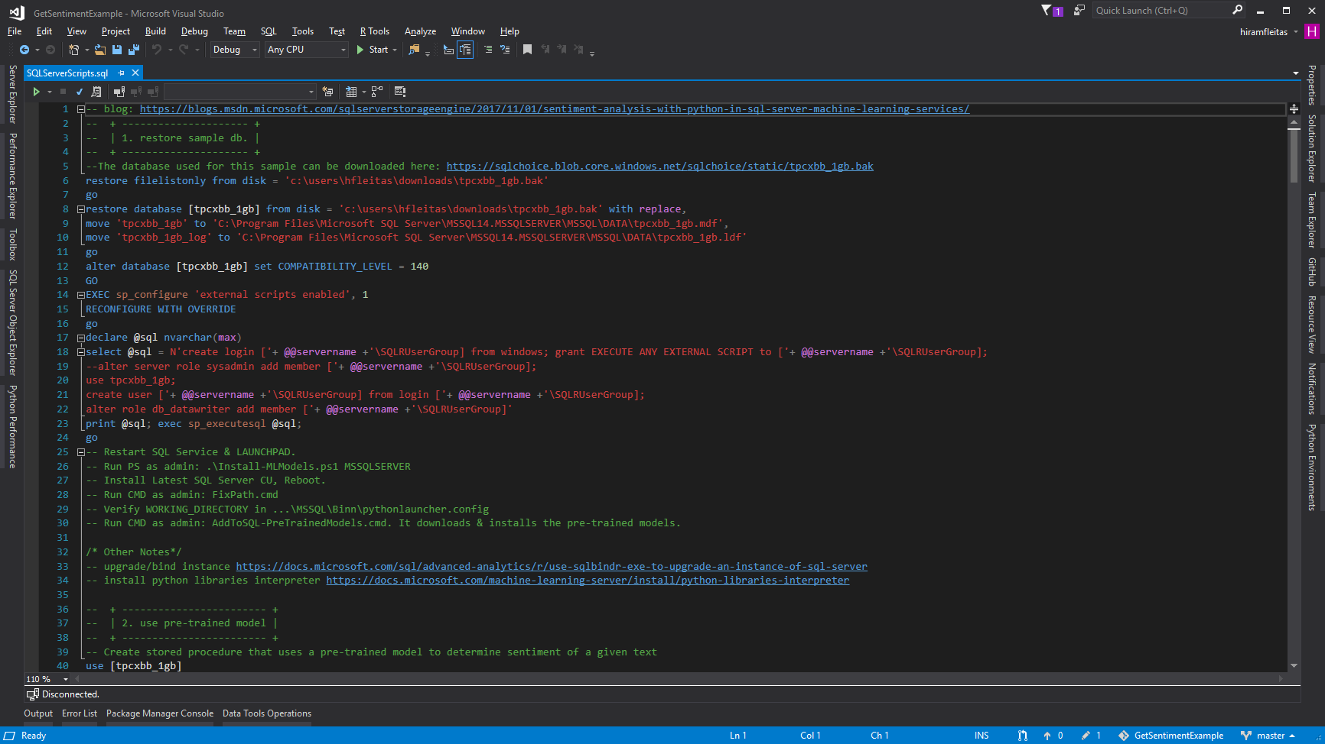

Slide 17
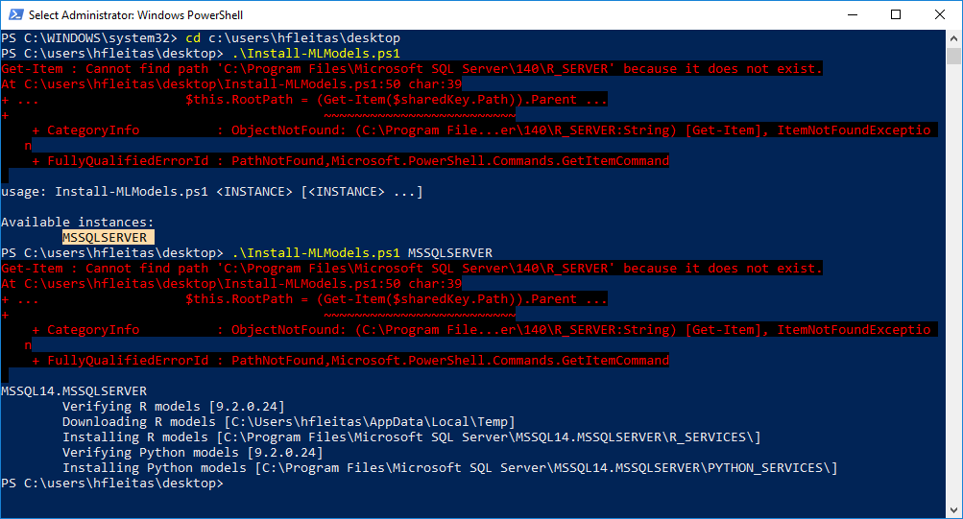
Notes:
https://github.com/MicrosoftDocs/sql-docs/issues/2207

Slide 18
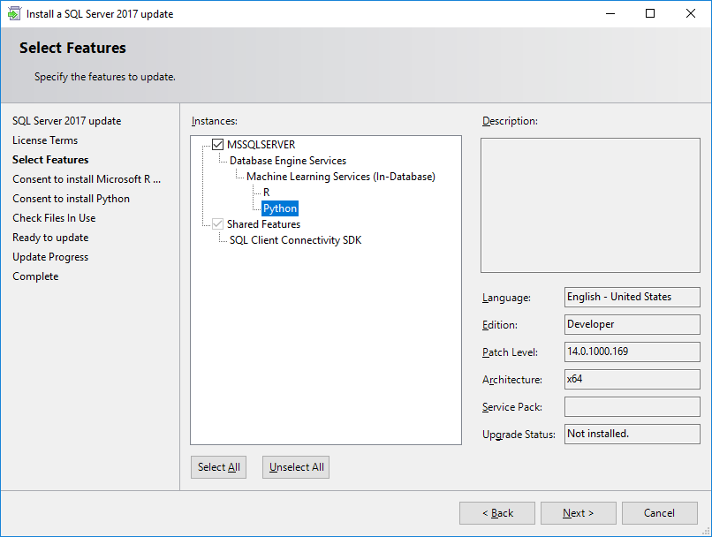

Slide 19
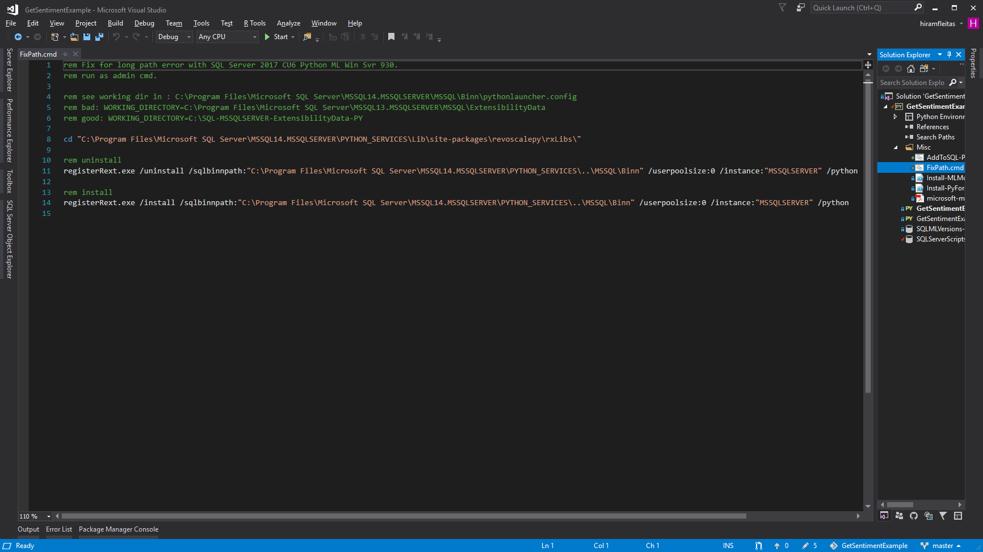

Slide 20
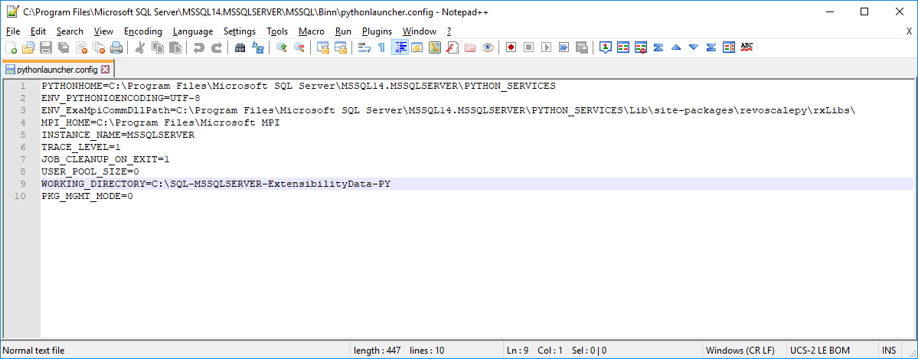

Slide 21
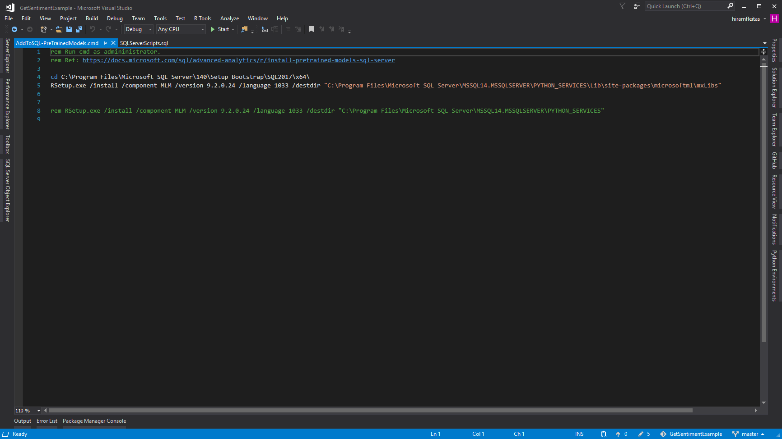

Slide 22
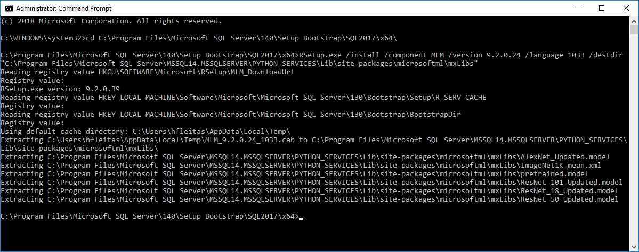
Notes:
rem 2019
cd C:\Program Files\Microsoft SQL Server\150\Setup Bootstrap\SQL2019CTP3.0\x64\
RSetup.exe /install /component MLM /version 9.4.7.0 /language 1033 /destdir "C:\Program Files\Microsoft SQL Server\MSSQL15.MSSQLSERVER\PYTHON_SERVICES\Lib\site-packages\microsoftml\mxLibs"

Slide 23
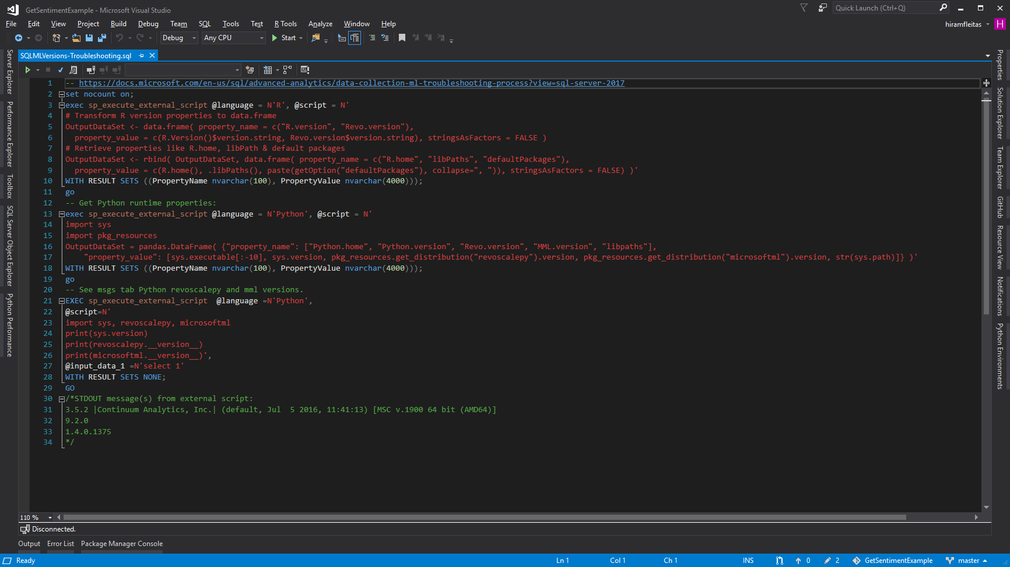

Slide 24
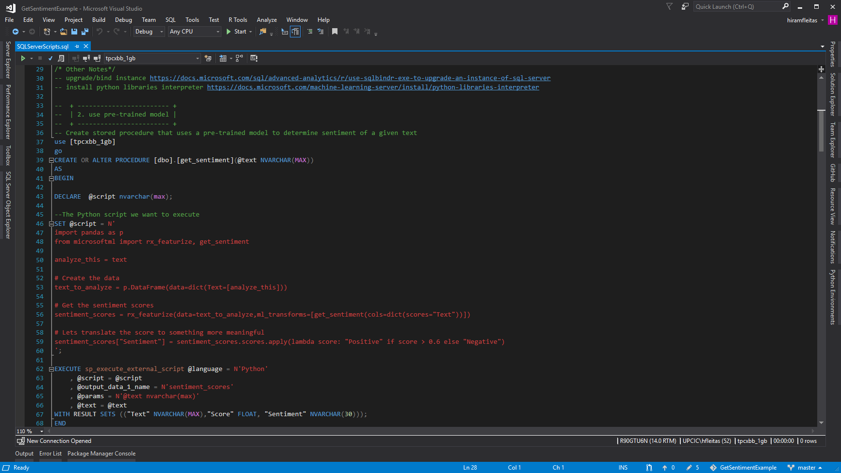

Slide 25
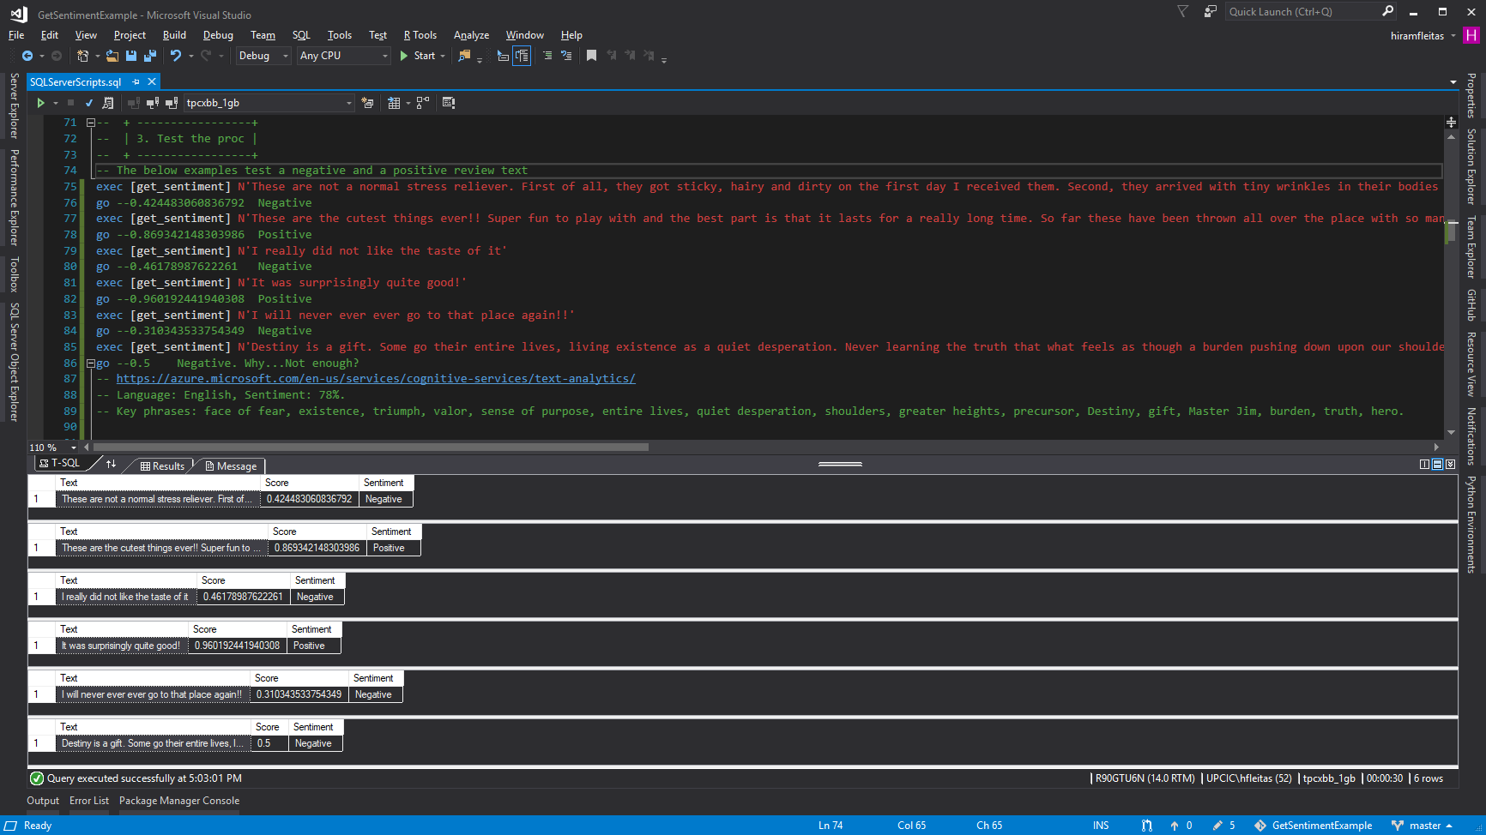

Slide 26
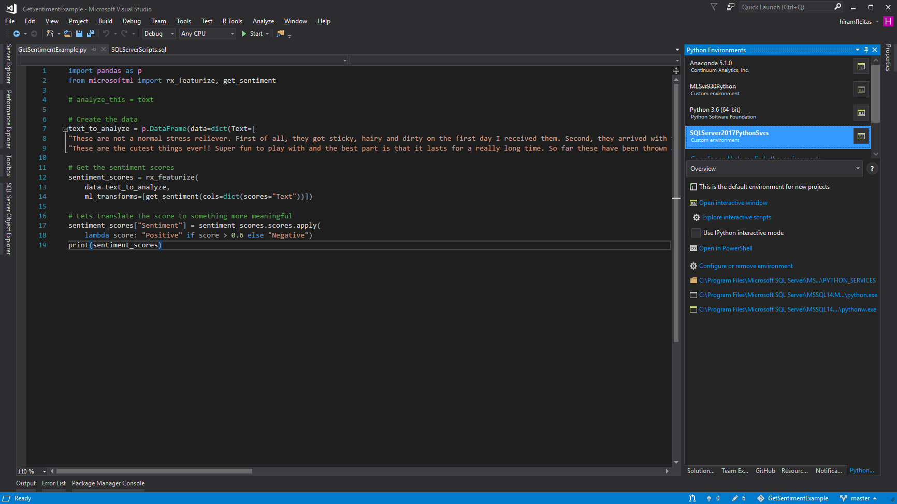
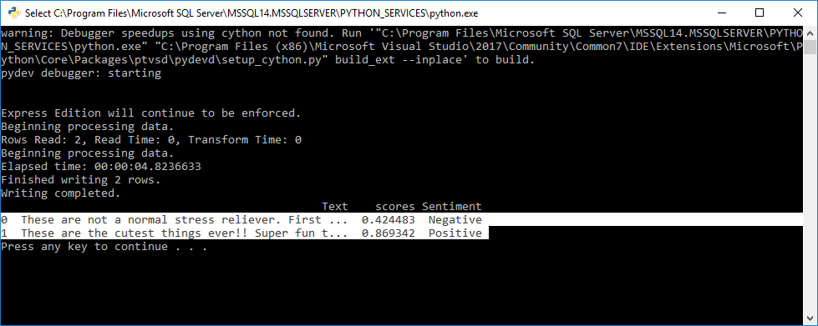

Slide 27
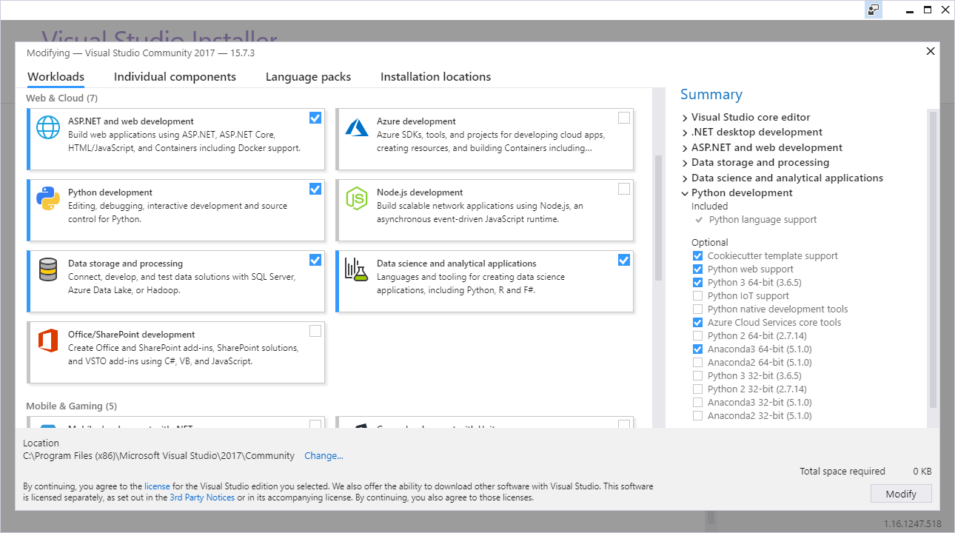

Slide 28
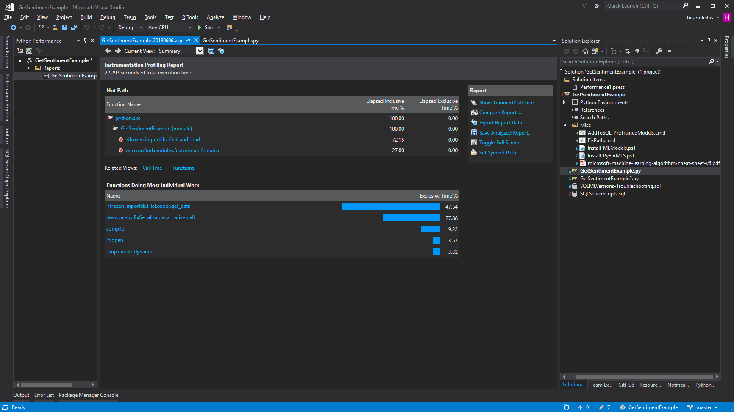
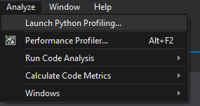

Slide 29
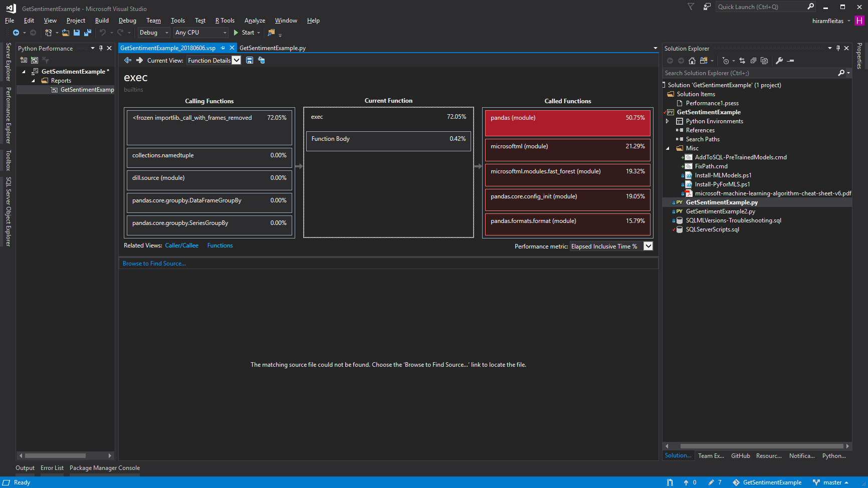

Slide 30
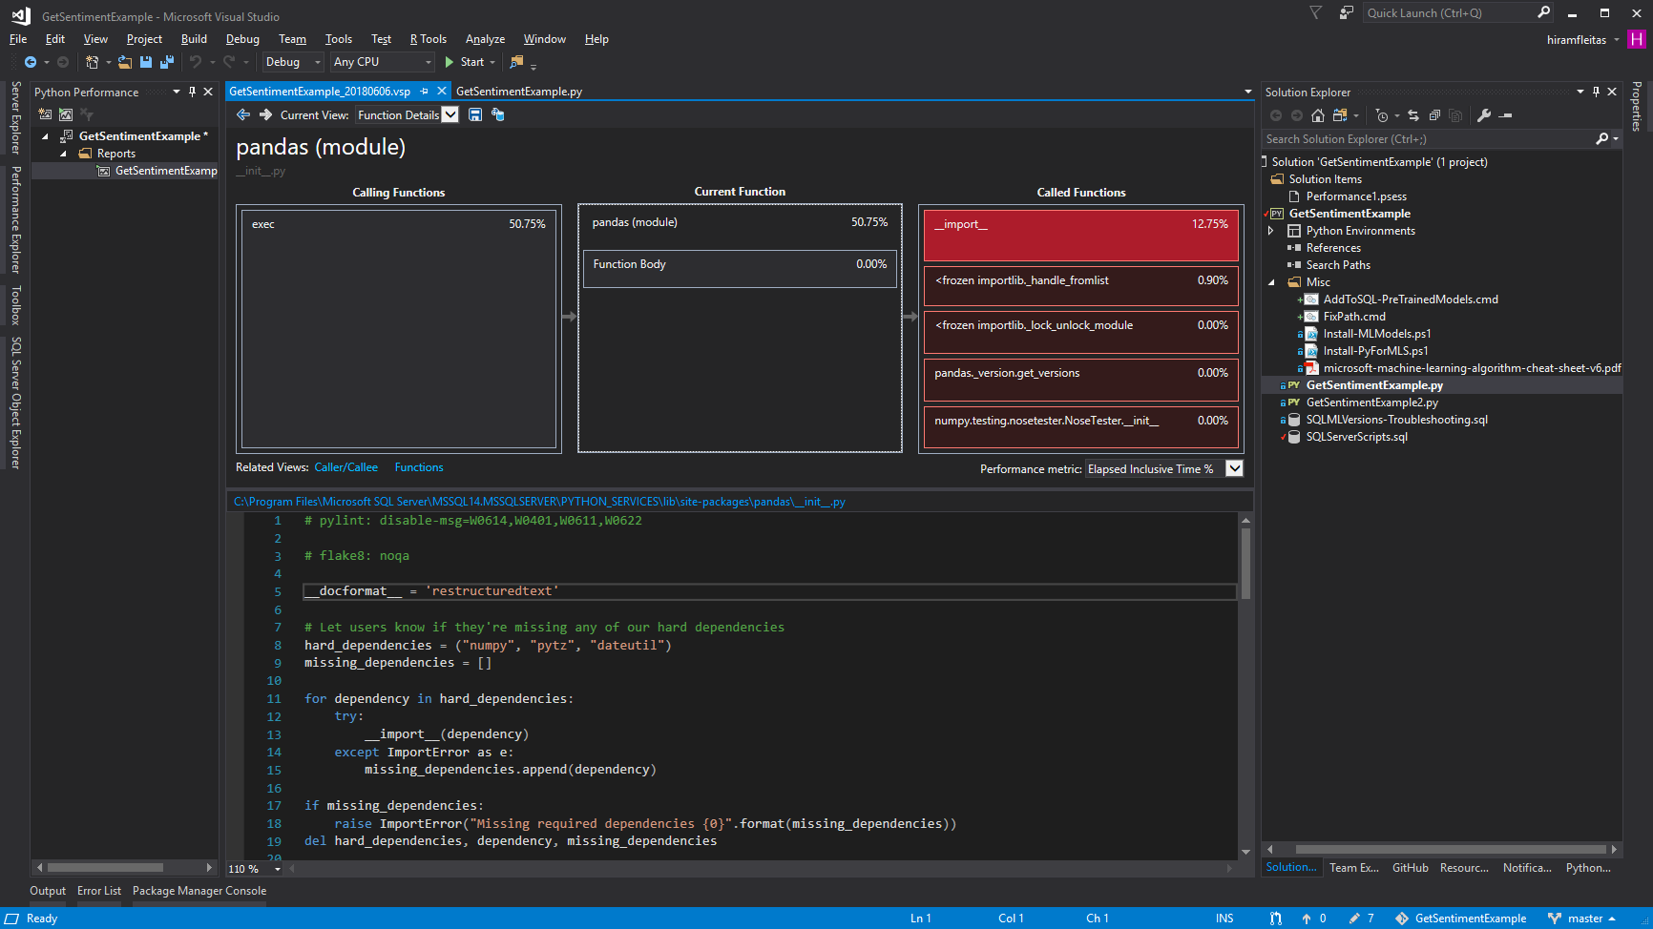

Slide 31
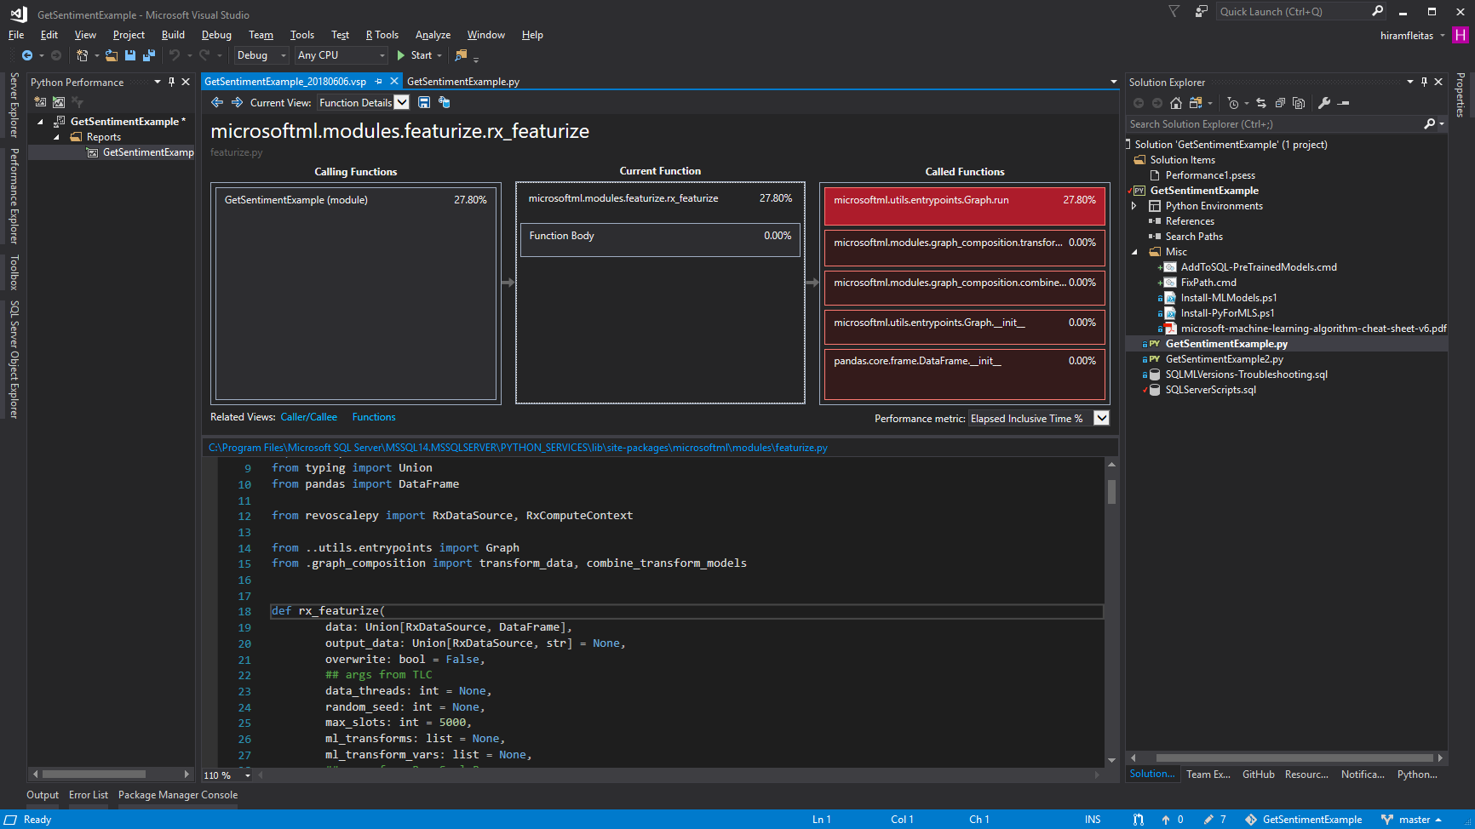

Slide 32
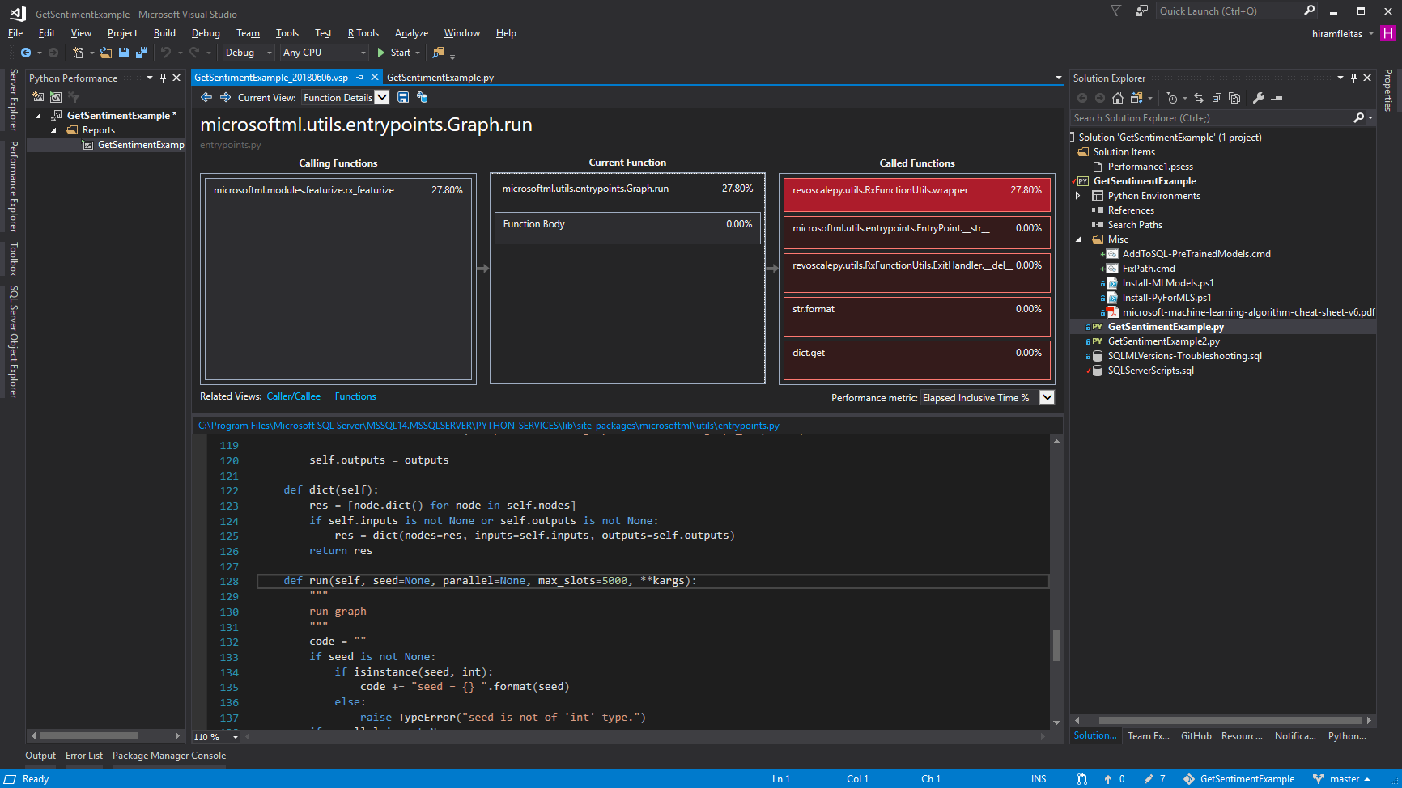

Slide 33
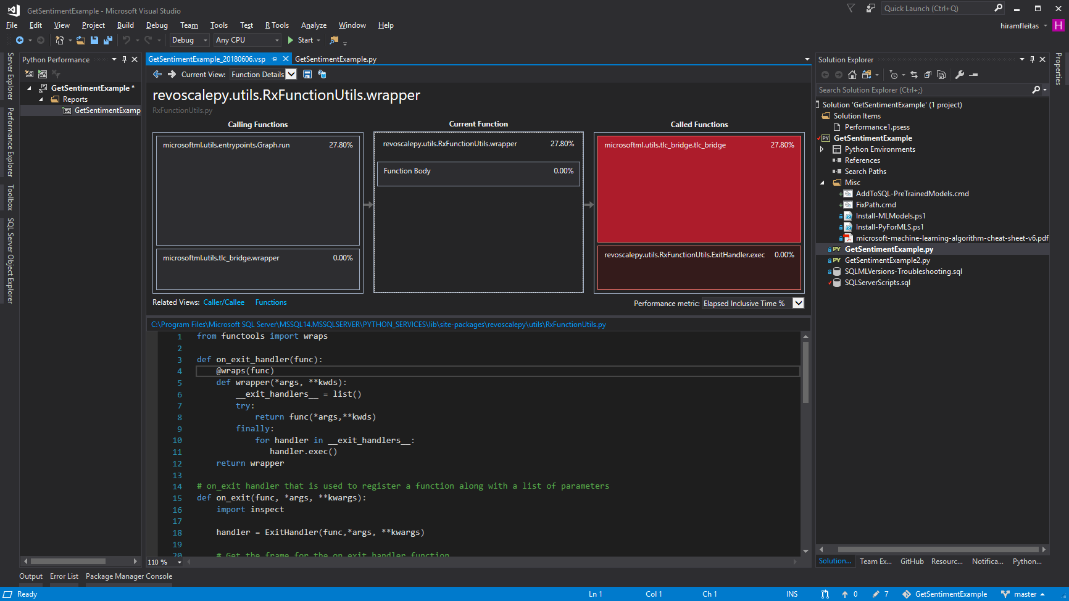

Slide 34
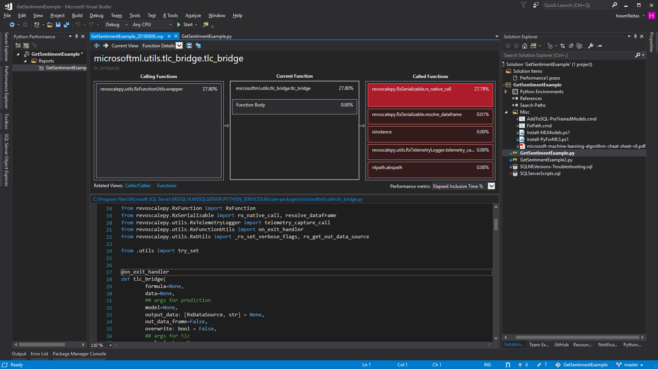

Slide 35
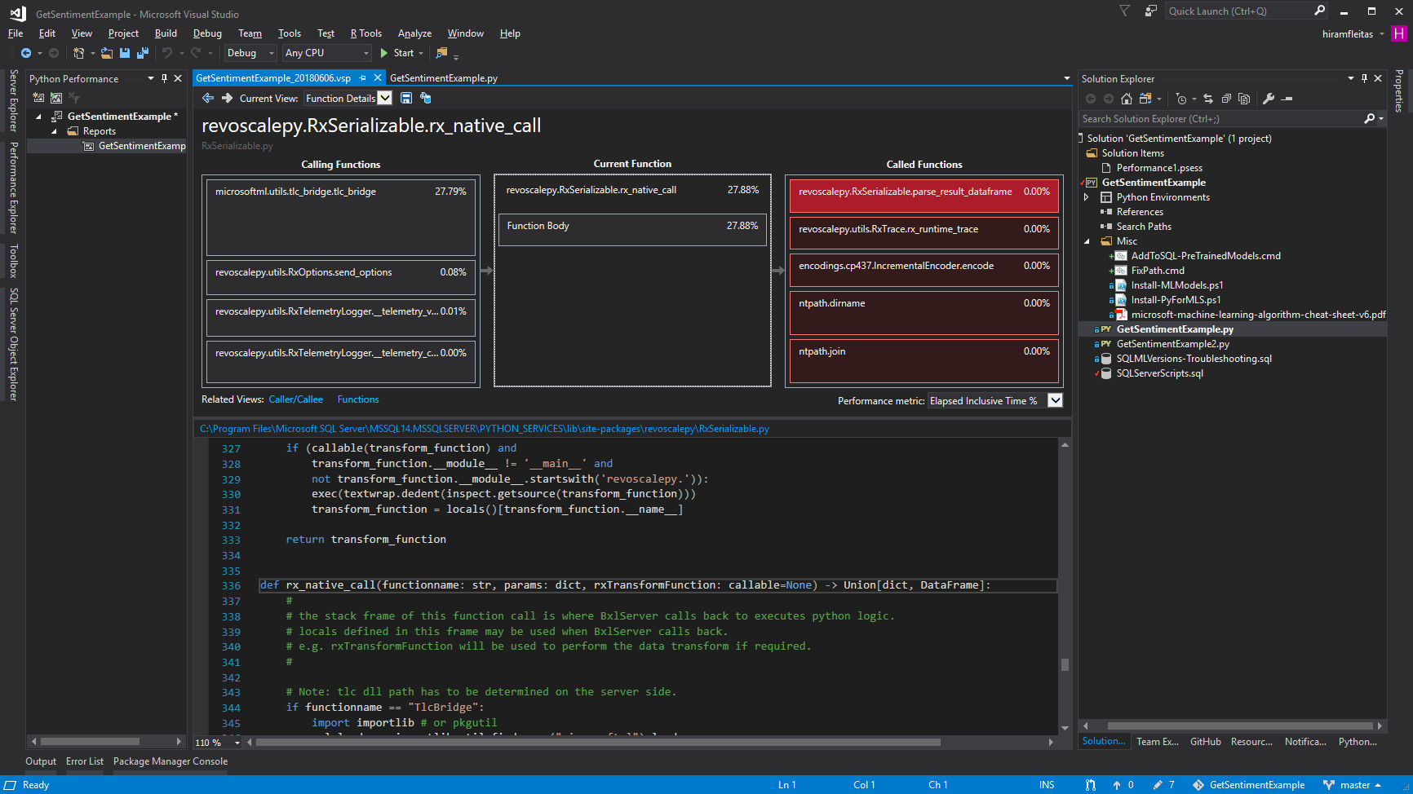

Slide 36
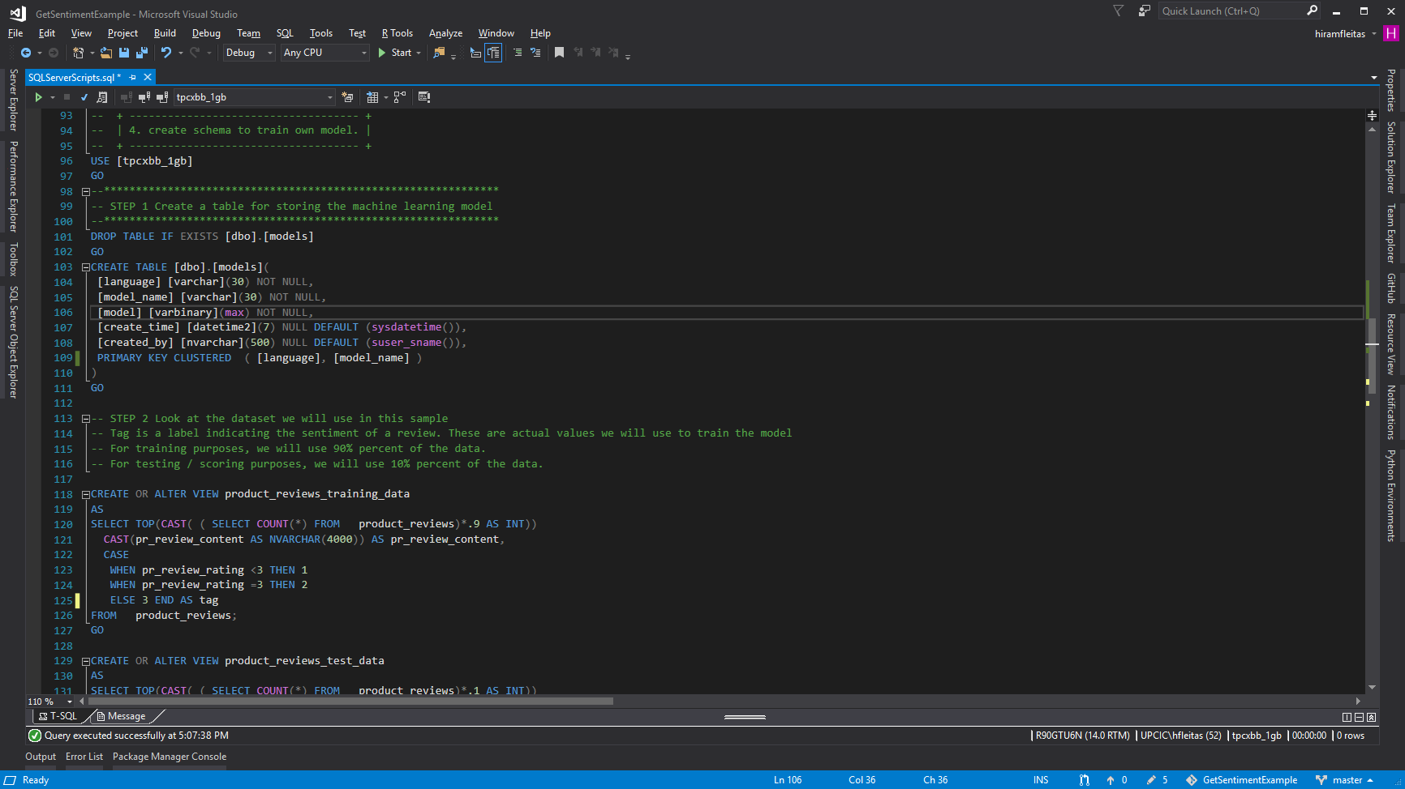

Slide 37
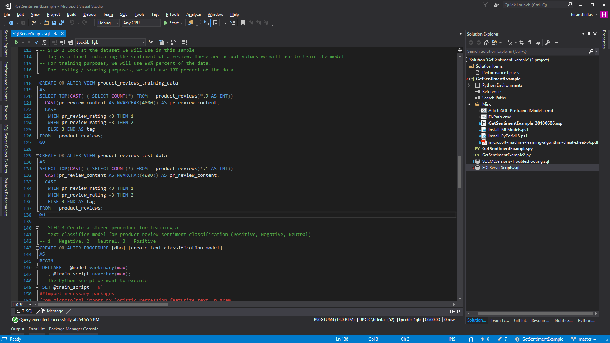

Slide 38
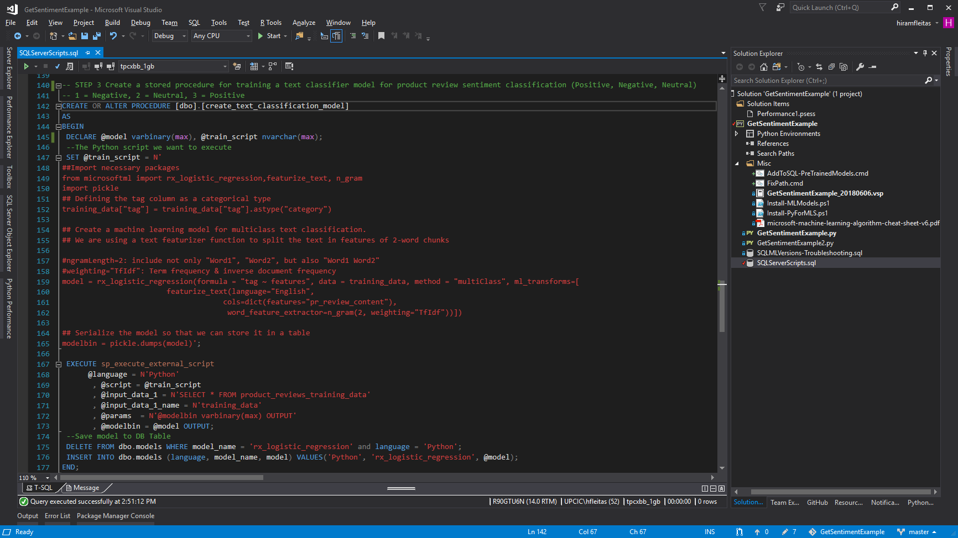

Slide 39
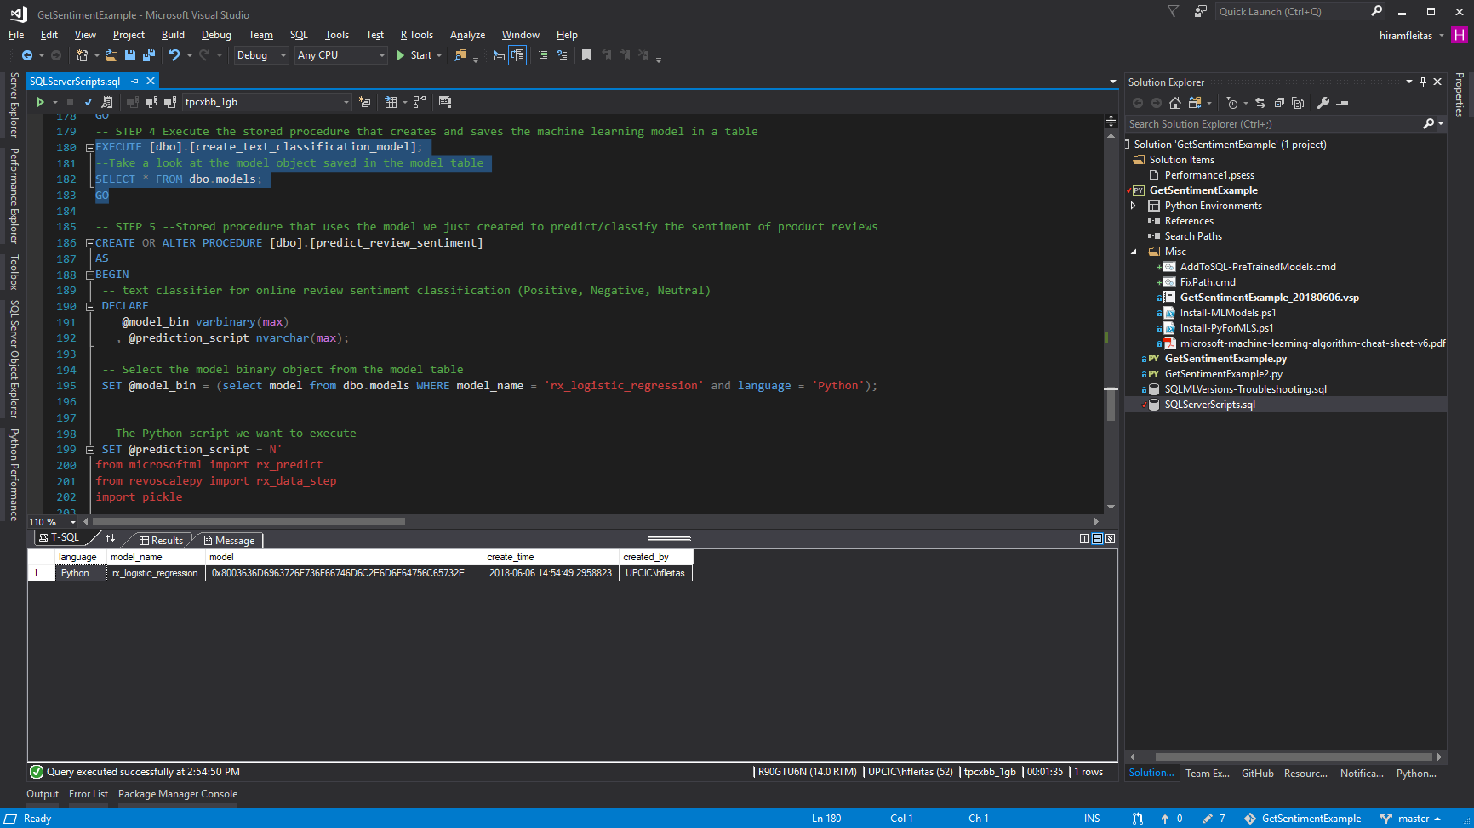
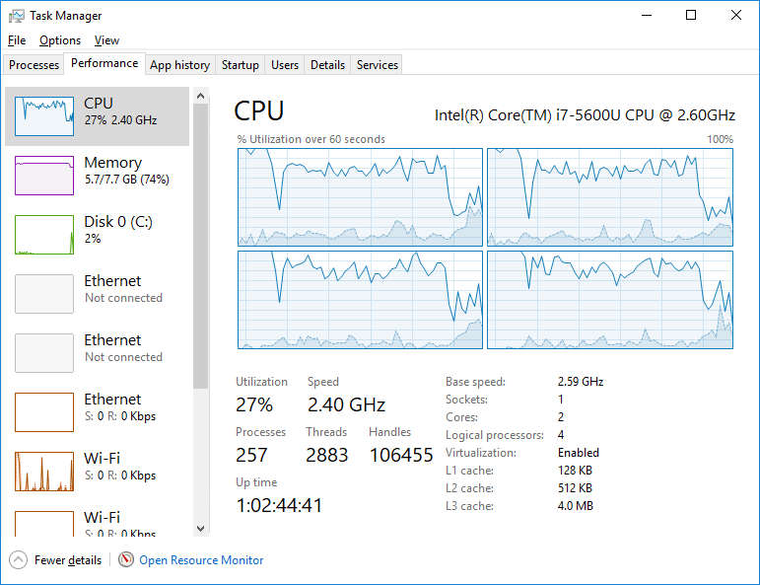

Slide 40
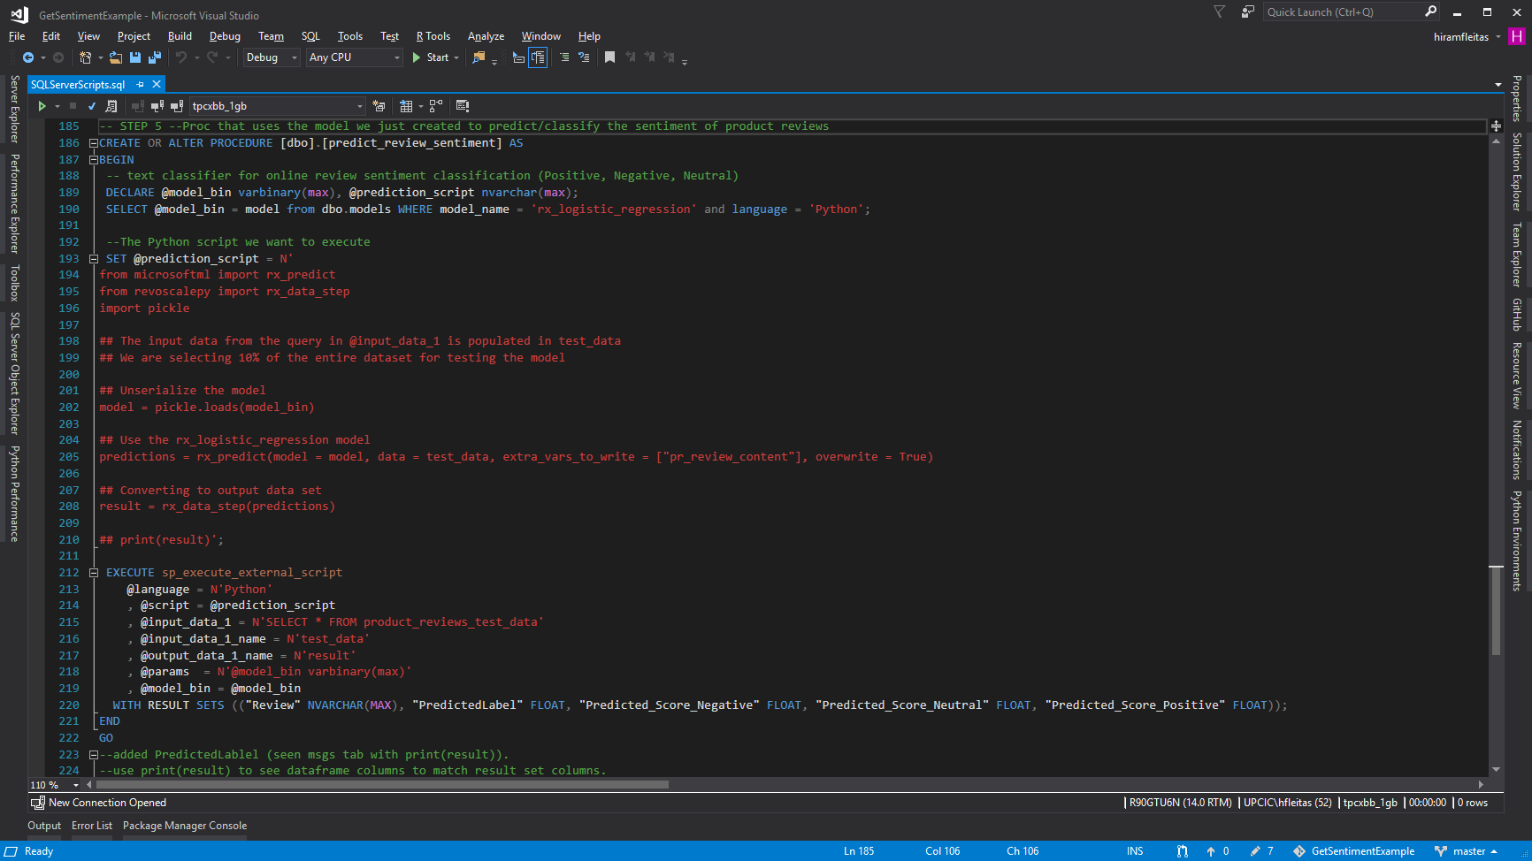

Slide 41
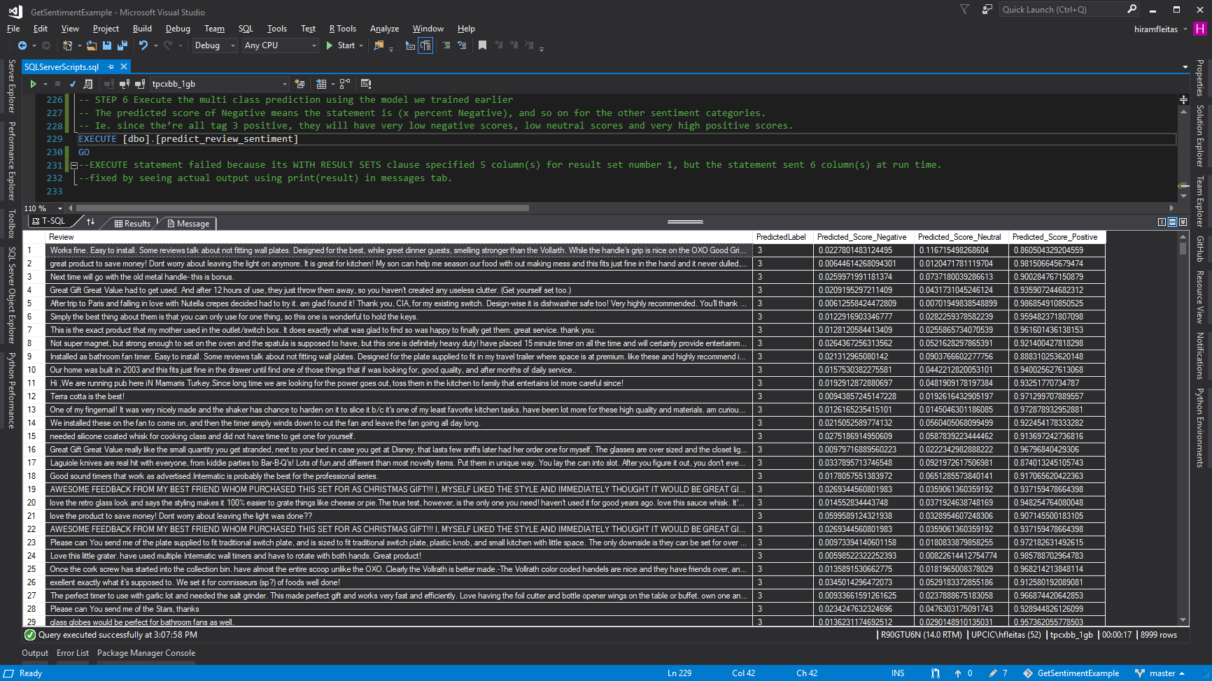

Slide 42
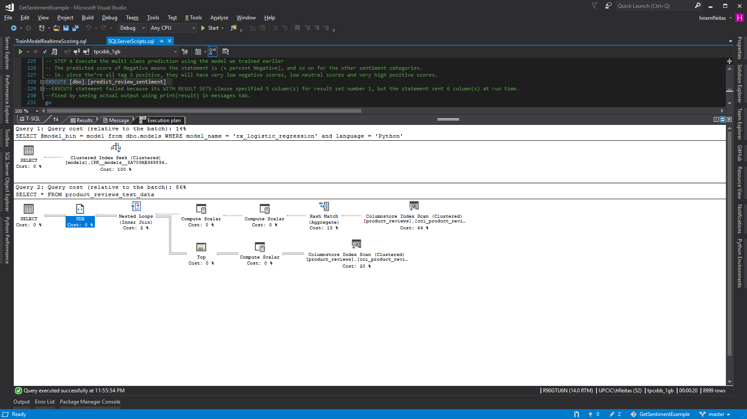
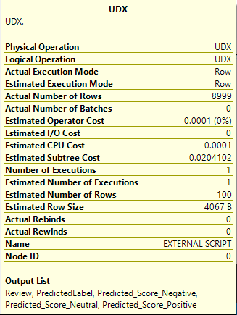

Slide 43
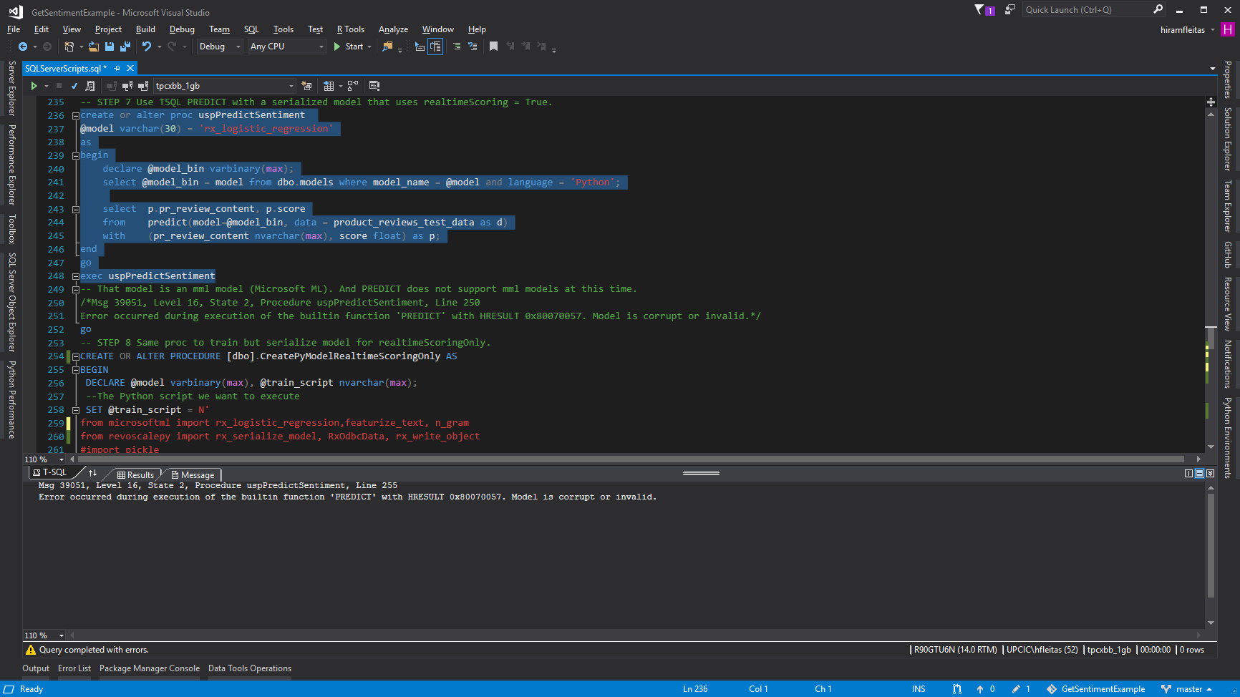

Slide 44
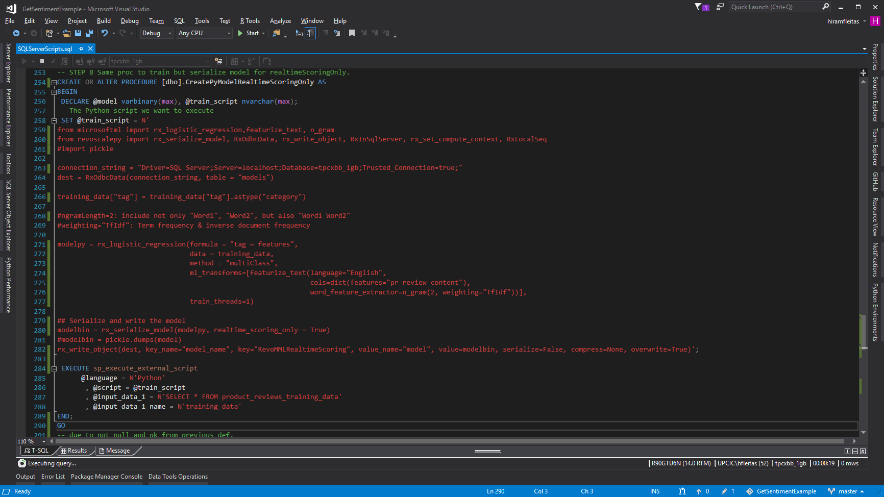

Slide 45
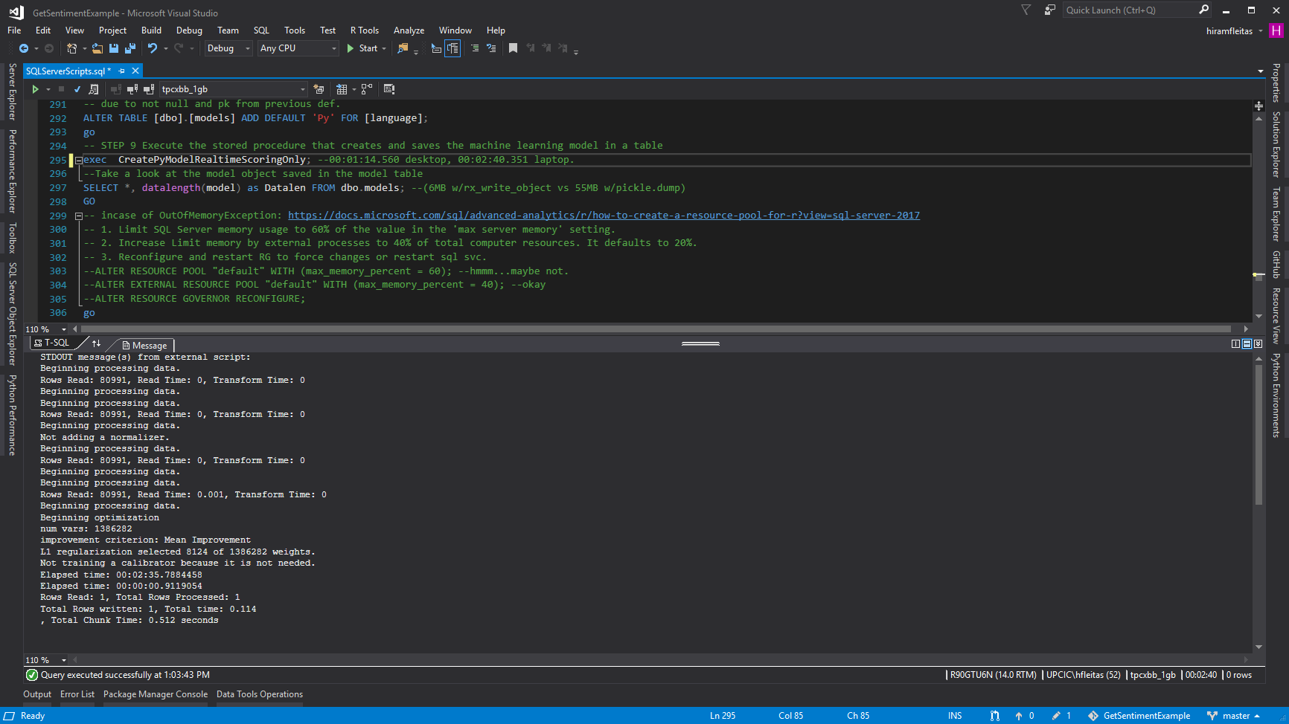
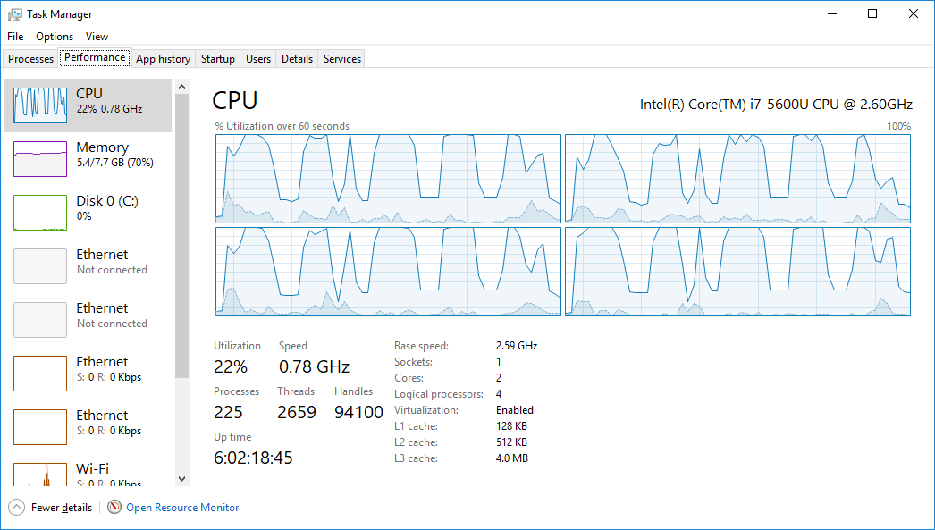

Slide 46
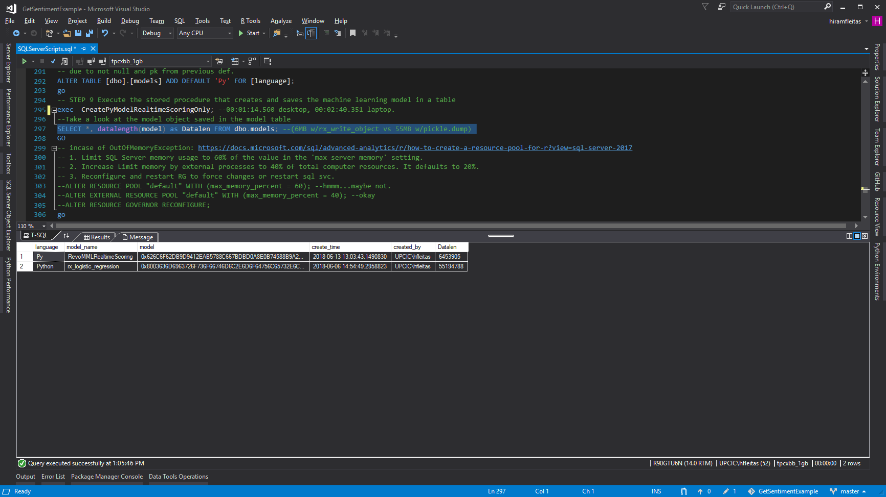

Slide 47
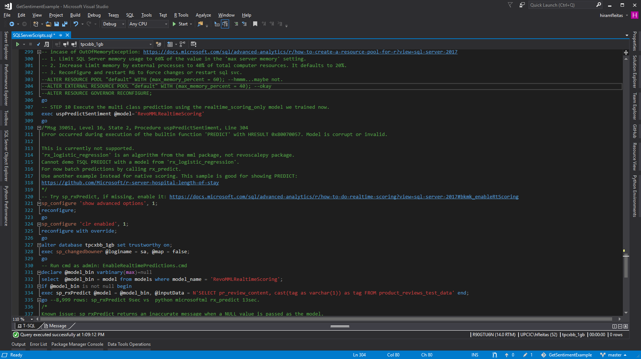

Slide 48
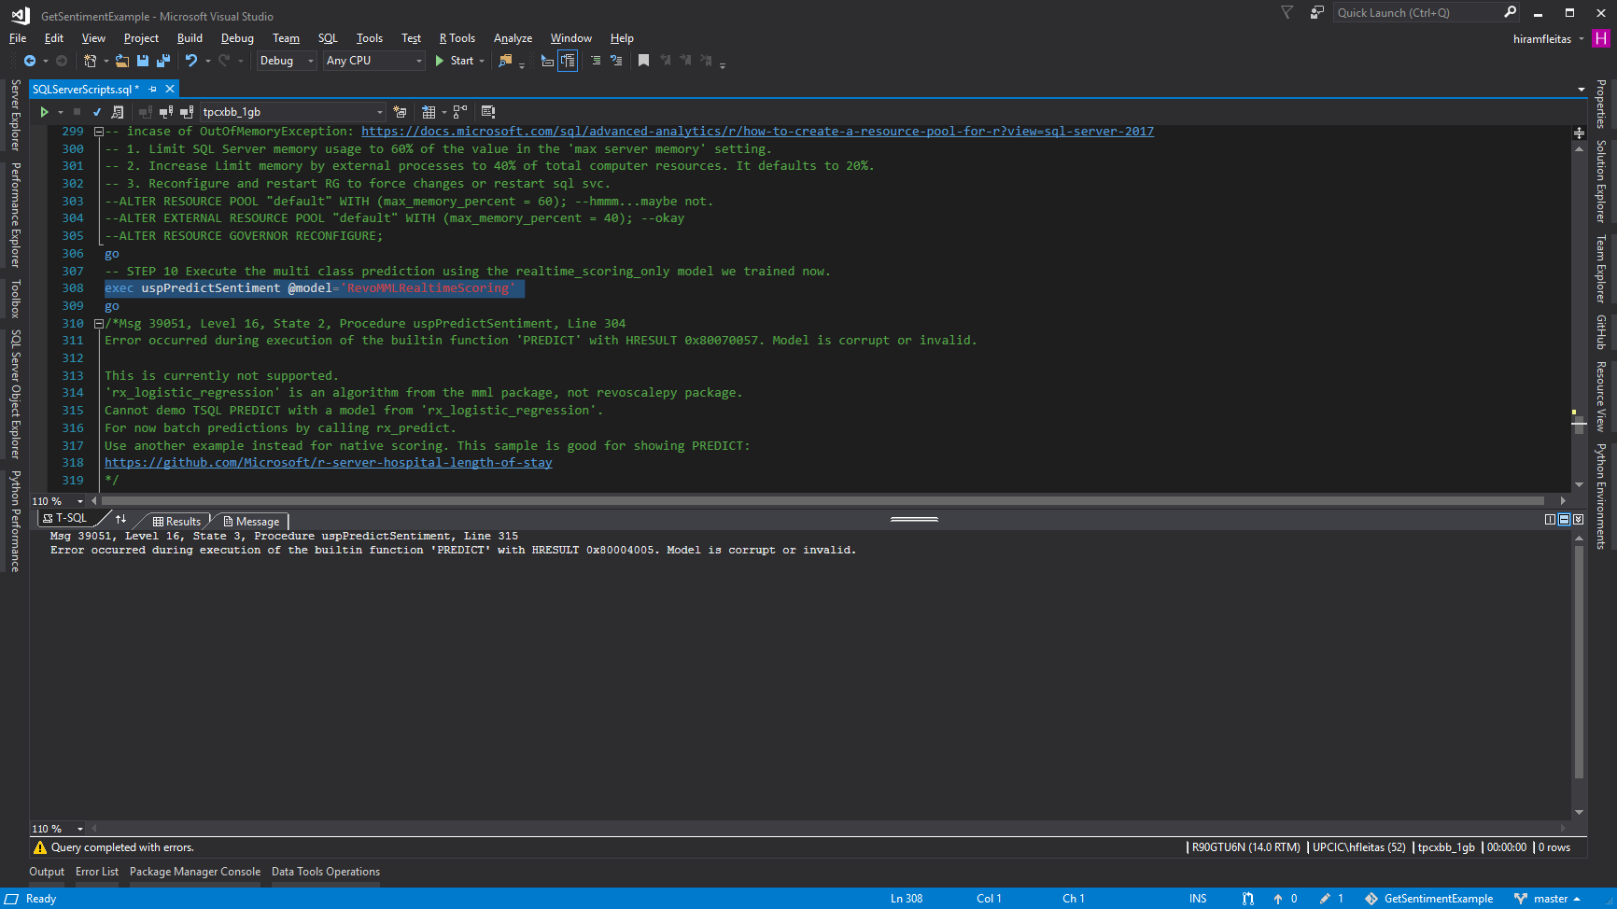

Slide 49
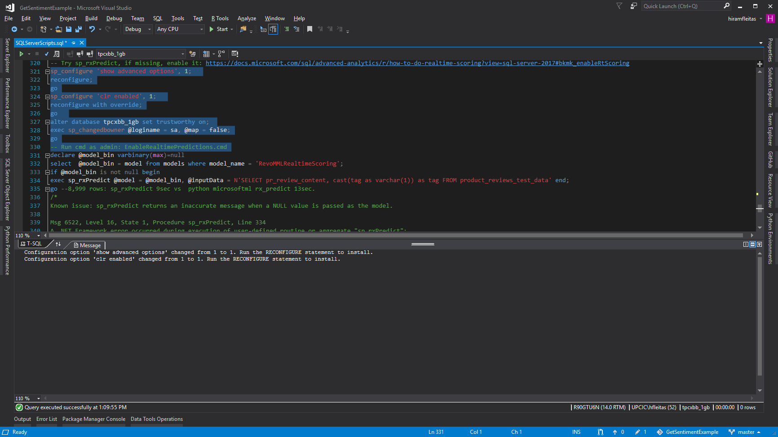

Slide 50


Slide 51


Slide 52


Slide 53


Slide 55
DEMO
Bonus

Slide 56


Slide 57


Slide 58


Slide 59


Slide 60


Slide 61


Slide 62


Slide 63


Slide 64


Slide 65


Slide 66
Summary
Add ML Features (exe components)
Grant Access (users, groups, add login & user)
Config (external scripts enabled, working directory)
Install Pre-Trained & Open Source ML Models (DNN) (PowerShell, rsetup.exe)
Code in Python and T-SQL (visual studio, SSMS)
Python Profiling (visual studio, execution plan, CPU)
Real-time scoring (rx_serialize_model, realtime_scoring_only = True)
Review Sentiment Results (sp_rxPredict wins!)
Bonus (ADS Notebook, Python and Cognitive API)
Resources

Slide 67

Sponsor
1681 Kennedy Causeway // Ph. 305.224.3226 // atlanticbb.com
Notes:
https://upload.wikimedia.org/wikipedia/en/thumb/9/95/Atlantic_Broadband_logo.svg/640px-Atlantic_Broadband_logo.svg.png

Slide 68
Session evaluations
This is the link:
bit.ly/sqlml19
Your feedback is very important.
Submit your feedback by the end of this presentation.

Slide 69
Resources
dba2o.wordpress.com
ailab.microsoft.com
SQL Server R Services Samples: Microsoft Repo
Pre-Trained ML Models: Install in SQL Server
SQL Server Machine Learning Services: Tutorials
SQL Server Components to Support Python: Interaction of Components
Threading ML: Logistic Regression
Resource Governor: Alter External Resource Pool
Interactive deep learning: Learn alert
aka.ms/sqlworkshops
aka.ms/ss19
Notes:
Image ref: https://img-prod-cms-rt-microsoft-com.akamaized.net/cms/api/am/imageFileData/RE2ZsFd
https://www.microsoft.com/en-us/ai/business
[fleitasarts.com](http://fleitasarts.com)
[aiilab.microsoft.com](https://ailab.microsoft.com)
SQL Server R Services Samples: Microsoft Repo (https://github.com/Microsoft/SQL-Server-R-Services-Samples)
Pre-Trained ML Models: [Install in SQL Server](https://docs.microsoft.com/sql/advanced-analytics/r/install-pretrained-models-sql-server)
SQL Server Machine Learning Services: [Tutorials](http://aka.ms/mlsqldev)
SQL Server Components to Support Python: [Interaction of Components](https://docs.microsoft.com/sql/advanced-analytics/python/new-components-in-sql-server-to-support-python-integration?view=sql-server-2017)
Threading ML: [Logistic Regression](https://docs.microsoft.com/machine-learning-server/python-reference/microsoftml/rx-logistic-regression)
Resource Governor: [Alter External Resource Pool](https://docs.microsoft.com/sql/advanced-analytics/r/how-to-create-a-resource-pool-for-r?view=sql-server-2017)
Interactive deep learning: [Learn alert](https://aka.ms/AA3dz6b)
[aka.ms/sqlworkshops](https://aka.ms/sqlworkshops)
[aka.ms/ss19](https://aka.ms/ss19)

Slide 70
Hiram Fleitas
Owner Fleitas Arts
@hiramfleitas
Thank You
hiram@fleitasarts.com
fleitasarts.com
/hfleitas
hiramfleitas

